Slide 1

Bahria University Karachi Campus
Data Mining
Session 9 - Clustering
Department of Software Engineering
Bahria University Karachi Campus
Notes:
https://www.youtube.com/watch?v=9OjRP0ZLKkk&list=PLLspfyoOYoQcI6Nno3gPkq0h5YSe81hsc&index=32

Slide 2
What is Cluster Analysis?
Finding groups of objects such that the objects in a group will be similar (or related) to one another and different from (or unrelated to) the objects in other groups
Inter-cluster distances are maximized
Intra-cluster distances are minimized
Notes:
Intra= Within, Inter= Between

Slide 3
Cont…
Cluster: A collection of data objects
similar (or related) to one another within the same group
dissimilar (or unrelated) to the objects in other groups
Cluster analysis (or clustering, data segmentation, …)
Finding similarities between data according to the characteristics found in the data and grouping similar data objects into clusters
Unsupervised learning: no predefined classes (i.e., learning by observations vs. learning by examples: supervised)

Slide 4
Examples of Clustering Applications
Information retrieval: document clustering
Marketing: Help marketers discover distinct groups in their customer bases, and then use this knowledge to develop targeted marketing programs
City-planning: Identifying groups of houses according to their house type, value, and geographical location
Earth-quake studies: Observed earth quake epicenters should be clustered along continent faults
Climate: understanding earth climate, find patterns of atmospheric and ocean
Economic Science: market research

Slide 5
What is not Cluster Analysis?
Simple segmentation
Dividing students into different registration groups alphabetically, by last name
Results of a query
Groupings are a result of an external specification
Clustering is a grouping of objects based on the data
Supervised classification
Have class label information
Association Analysis
Local vs. global connections

Slide 6
Notion of a Cluster can be Ambiguous
How many clusters?
Six Clusters
Two Clusters
Four Clusters
Notes:
position is same but different features/properties
So we need to discover the patterns and characteristics of the objects

Slide 7
Quality: What Is Good Clustering?
A good clustering method will produce high quality clusters
high intra-class similarity: cohesive within clusters
low inter-class similarity: distinctive between clusters
The quality of a clustering method depends on
the similarity measure used by the method
its implementation, and
Its ability to discover some or all of the hidden patterns
Notes:
Intra= Within, Inter= Between … Cohesive: Compactness

Slide 8
Types of Clusterings
A clustering is a set of clusters
Important distinction between hierarchical and partitional sets of clusters
Partitional Clustering
A division of data objects into non-overlapping subsets (clusters) such that each data object is in exactly one subset
Hierarchical clustering
A set of nested clusters organized as a hierarchical tree

Slide 9
Partitional Clustering
Original Points
A Partitional Clustering

Slide 10
Hierarchical Clustering
Traditional Hierarchical Clustering
Traditional Dendrogram
Non-traditional Hierarchical Clustering
Non-traditional Dendrogram
Notes:
Traditional: Follow bottom to top. …… Non-trad: Top to bottom
https://www.youtube.com/watch?v=7enWesSofhg

Slide 11
Measure the Quality of Clustering
Dissimilarity/Similarity metric
Similarity is expressed in terms of a distance function, typically metric: d(i, j)
The definitions of distance functions are very different for interval-scaled, boolean, categorical, ordinal ratio, and vector variables
Weights should be associated with different variables based on applications and data semantics
Quality of clustering:
There is usually a separate “quality” function that measures the “goodness” of a cluster.
It is hard to define “similar enough” or “good enough”
The answer is typically highly subjective

Slide 12
Clustering Algorithms
K-means and its variants
Hierarchical clustering
Density-based clustering

Slide 13
K-means Clustering
Partitional clustering approach
Number of clusters, K, must be specified
Each cluster is associated with a centroid (center point)
Each point is assigned to the cluster with the closest centroid
The basic algorithm is very simple

Slide 14
The K-Means Clustering Method
Given k, the k-means algorithm is implemented in four steps:
Partition objects into k nonempty subsets
Compute seed points as the centroids of the clusters of the current partitioning (the centroid is the center, i.e., mean point, of the cluster)
Assign each object to the cluster with the nearest seed point
Go back to Step 2, stop when no more new assignment
Notes:
https://www.youtube.com/watch?v=CLKW6uWJtTc

Slide 15
K-Mean [Example]
{2,3,4,10,11,12,20,25,30}
Assume K=2
Lets select 2 random centroids in given points
C1=4, C2=12
4
12
Notes:
https://youtu.be/YWgcKSa_2ag?t=237

Slide 16
K-Mean [Example]
{2,3,4,10,11,12,20,25,30}
Assume K=2
Lets select 2 random centroids in given points
{2,3,4,10,11,12,20,25,30}
C1=4, C2=12
Find the difference (e.g. 4-3=1 and 12-3=9) and put in K1 or K2 whichever nearest
K1={2,3,4}
K2={10,11,12,20,25,30}
C1=(2+3+4)/3= 3
C2=(10+11+12+20+25+30)/6= 18
Now find the difference with new centroids → C1=3, C2=18.
K1= {2,3,4,10}
K2= {11,12,20,25,30)
C1= (2+3+4+10)/4 = 4.75
C2= (11+12+20+25+30)/5=19.6
4
12
3
18
Notes:
https://youtu.be/YWgcKSa_2ag?t=237

Slide 17
K-Mean [Example] Cont…
4.75
19.6
Now new centroid are C1=4.75, C2=19.6
-Every time update centroids and find differences.
-We will stop once we get same mean or centroids.
After certain iterations we get:
K1={2,3,4,10,11,12}
K2={20,25,30}
Notes:
https://youtu.be/YWgcKSa_2ag?t=237

Slide 18
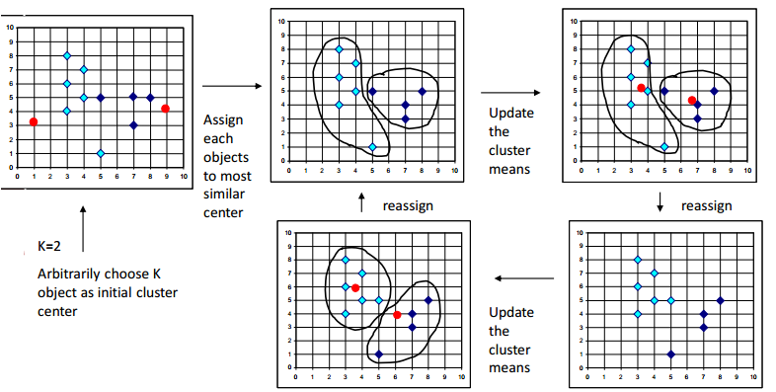
The K-Means Clustering Method (Cont’d)
Example

Slide 19
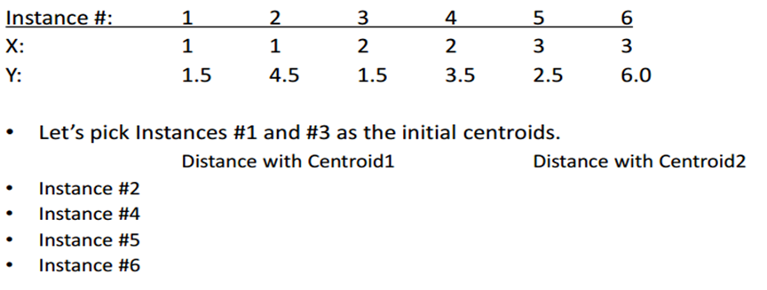
Working of the K-Mean Algorithm

Slide 20
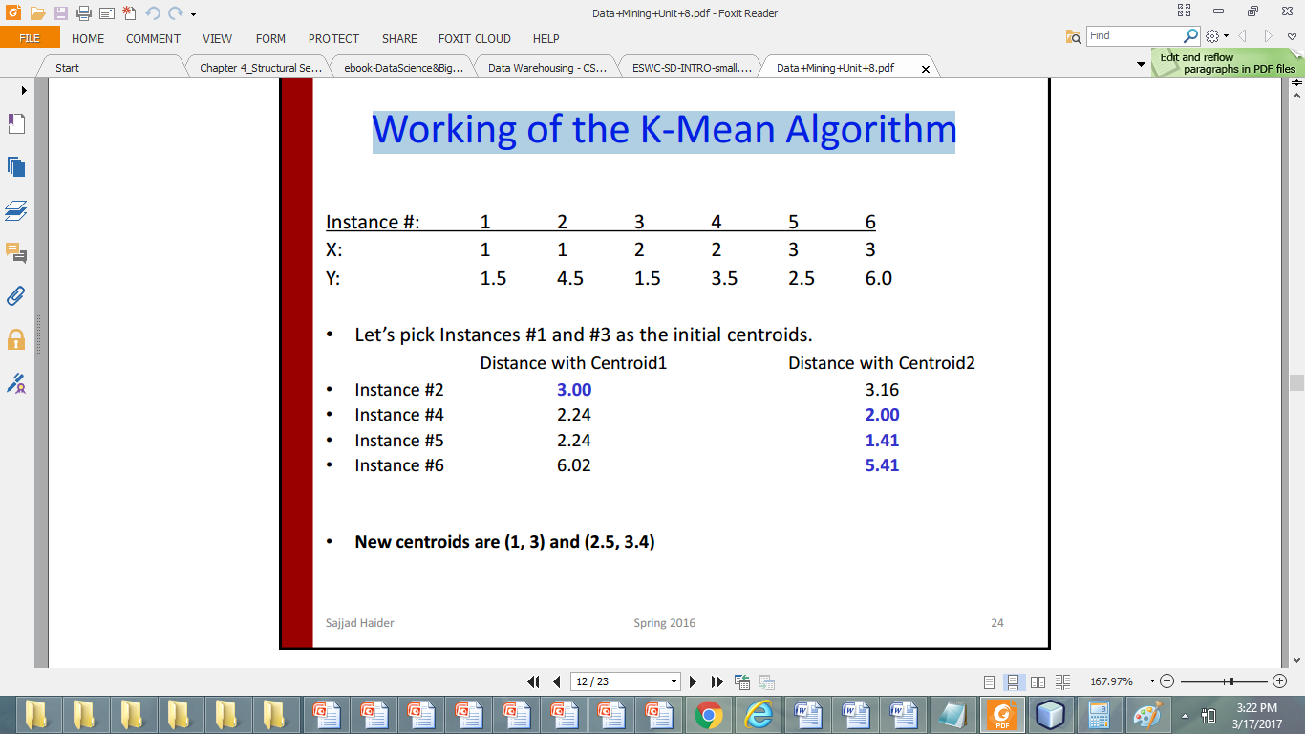
Working of the K-Mean Algorithm
See the next slide for computation
Values in blue are select because of Minimum/Closest distance.

Slide 21
Simply average them:

Slide 22
Comments on the K-Means Method
Applicable only to objects in a continuous n-dimensional space
Using the k-modes method for categorical data
In comparison, k-medoids can be applied to a wide range of data
Need to specify k, the number of clusters, in advance
Sensitive to noisy data and outliers
Not suitable to discover clusters with non-convex shapes
Often terminates at a local optimum
Notes:
Continous: any real number values <><> Categorical: data in different categories e.g. age, qualification, marital status
k-modes is an extension of k-means. Instead of distances it uses dissimilarities (that is, quantification of the total mismatches between two objects: the smaller this number, the more similar the two objects).

Slide 23
Two different K-means Clusterings
Original Points
Optimal Clustering
Sub-optimal Clustering

Slide 24
Importance of Choosing Initial Centroids

Slide 25
Importance of Choosing Initial Centroids

Slide 26
Importance of Choosing Initial Centroids …

Slide 27
Importance of Choosing Initial Centroids …

Slide 28
Solutions to Initial Centroids Problem
• Multiple runs – Helps, but probability is not on your side
• Select more than k initial centroids and then select among these initial centroids – Select most widely separated
• Bisecting K-means – Not as susceptible to initialization issues

Slide 29
Pre-processing and Post-processing
• Pre-processing – Normalize the data – Eliminate outliers
• Post-processing – Eliminate small clusters that may represent outliers – Split ‘loose’ clusters, i.e., clusters with relatively high SSE (Sum of Squared Error)

Slide 30
What Is the Problem of the K-Means Method?
The k-means algorithm is sensitive to outliers!
Since an object with an extremely large value may substantially distort the distribution of the data
K-Medoids: Instead of taking the mean value of the object in a cluster as a reference point, medoids can be used, which is the most centrally located object in a cluster
10
10
9
9
8
8
7
7
6
6
5
5
4
4
3
3
2
2
1
1
0
0
1
2
3
4
5
6
7
8
9
10
0
0
1
2
3
4
5
6
7
8
9
10

Slide 31
Cluster Validity
• For supervised classification we have a variety of measures to evaluate how good our model is – Accuracy, precision, recall
• For cluster analysis, the analogous question is how to evaluate the “goodness” of the resulting clusters?
• But “clusters are in the eye of the beholder”!
• Then why do we want to evaluate them? – To avoid finding patterns in noise – To compare clustering algorithms – To compare two sets of clusters – To compare two clusters

Slide 32
Measures of Cluster Validity
• Numerical measures that are applied to judge various aspects of cluster validity, are classified into the following three types. – External Index: Used to measure the extent to which cluster labels match externally supplied class labels. • Entropy – Internal Index: Used to measure the goodness of a clustering structure without respect to external information. • Sum of Squared Error (SSE) – Relative Index: Used to compare two different clusterings or clusters. • Often an external or internal index is used for this function, e.g., SSE or entropy
Notes:
External Index: Compare the Clustering results to ground truth (labelled data).
Inernal: Use only data.

Slide 33
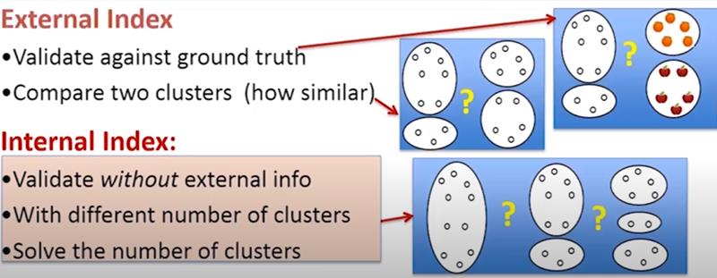
Notes:
External Index: Compare the Clustering results to ground truth (labelled data).
Inernal: Use only data.

Slide 34
Internal Measures: Cohesion and Separation
• Cluster Cohesion: Measures how closely related are objects in a cluster – Example: SSE
• Cluster Separation: Measure how distinct or well-separated a cluster is from other clusters

Slide 35
Example
Cohesion is measured by the within cluster sum of squares (SSE)
Separation is measured by the between cluster sum of squares
Where |C_{i}| is the size of cluster i
Notes:
Ci= Cluster i

Slide 36
Cohesion and Separation: Example
Example: SSE
BSS + WSS = constant
m
×
×
×
1
m₁
2
3
4
m₂
5
K=1 cluster:
K=2 clusters:

Slide 37
Internal Measures: Cohesion and Separation Cont…
A proximity graph based approach can also be used for cohesion and separation.
Cluster cohesion is the sum of the weight of all links within a cluster.
Cluster separation is the sum of the weights between nodes inside the cluster and nodes outside the cluster.
cohesion
separation

Slide 38
External Measures of Cluster Validity: Entropy and Purity

Slide 39
Calculation
Entrophy:
Row:[ -(3/677 log₂ (3/677) + 5/677 log₂ (5/677) + 40/677 log₂ (40/677) + 506/677 log₂ (506/677) + 96/677 log₂ (96/677) + 27/677 log₂ (27/677))]
Total: 354/3204*1.227 + 555/3204*1.1472 + 341/3204*0.1813+ ………………..(Total(column)/Total*Entropy(Row)
Purity:
Row: 506/677 (max/total)
Total: 354/3204*0.7474 + 555/3204*0.7756+ 341/3204*0.9796 + ……………….. (Total(column)/Total*Purity(Row)

